Slide 1
Opening A New Sushi Restaurant in Toronto
Coursera Applied Data Science Capstone Project
Caiwei Guo

Slide 2
Introduction
Goal: to find a location for a new sushi restaurant in Toronto
Targeting audience: restaurant owners who want to open a sushi restaurant
Criteria
Not many similar restaurants around
Close to other venues, like movie theaters, gyms, etc.

Slide 3
Data
Geographical data of Toronto
Scraping from a Wikipedia page and a csv file
https://en.wikipedia.org/wiki/List_of_postal_codes_of_Canada:_M
http://cocl.us/Geospatial_data
Information about venues in Toronto
Obtaining from Foursquare API

Slide 4
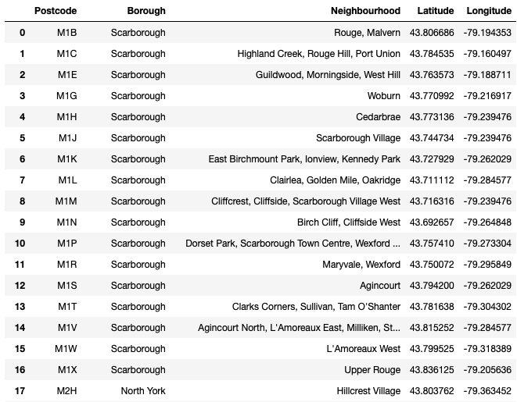
Methods
Generate the geographical data of Toronto (103 postcodes)

Slide 5
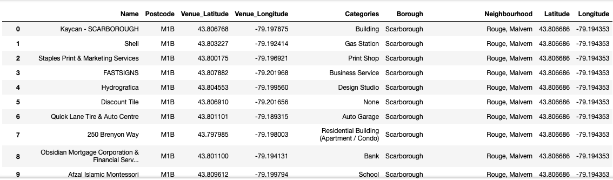
Methods
Obtain venue information from Foursquare (3850 venues)

Slide 6
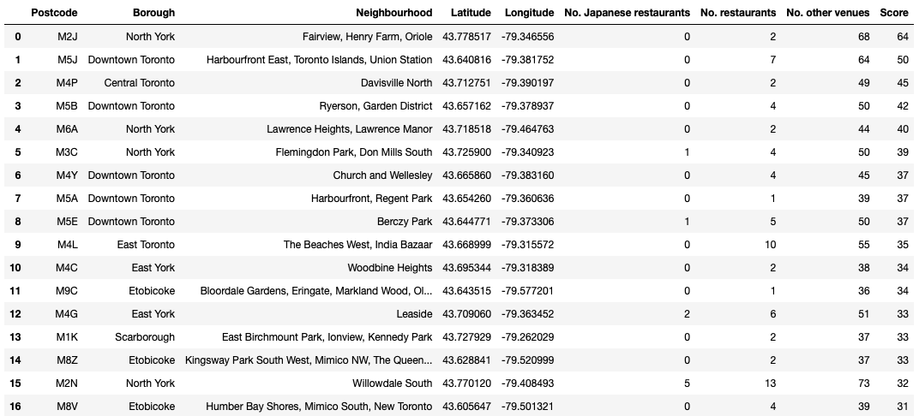
Methods
Count venues under each postcode

Slide 7
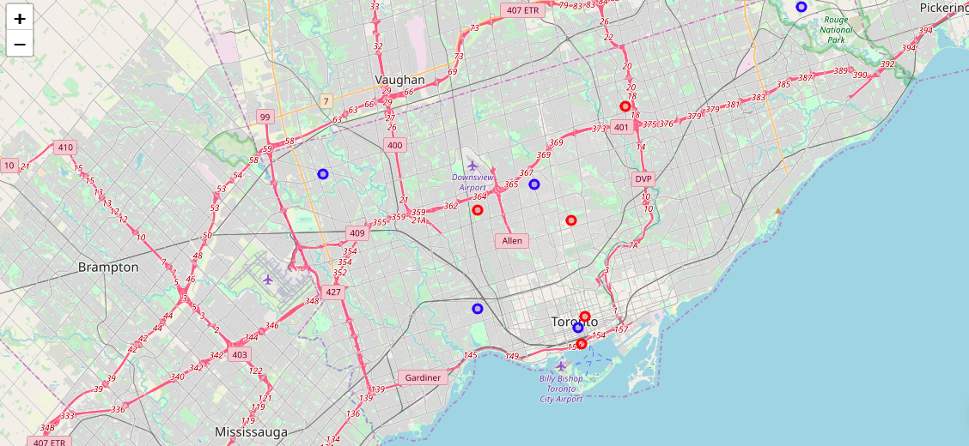
Results
Top ranked neighborhoods (red circles)
Fairview, Henry Farm, Oriole (M2J)
Harbourfront East, Toronto Islands, Union Station (M5J)
Davisville North (M4P)
Lawrence Heights, Lawrence Manor (M6A)
Ryerson, Garden District (M5B)
Bottom ranked neighborhoods
Adelaide, King, Richmond (M5H)
Upper Rouge (M1X)
Albion Gardens, Beaumond Heights, Humbergate, Jamestown, Mount Olive, Silverstone, South Steeles, Thistletown (M9V)
High Park, The Junction South (M6P)
Bedford Park, Lawrence Manor East (M5M)

Slide 8
Discussion
We noticed that two red circles (M5J, M5B) are very close to a blue circle (M5H). Thus these two neighborhoods (Harbourfront East, Toronto Islands, Union Station and Ryerson, and Garden District) might not be a good option either.

Slide 9
Conclusion
In conclusion, there are 3 neighborhoods in which we will suggest to open a new sushi restaurants. They are Fairview, Henry Farm, Oriole (M2J), Davisville North (M4P), Lawrence Heights, and Lawrence Manor (M6A).

